Slide 2
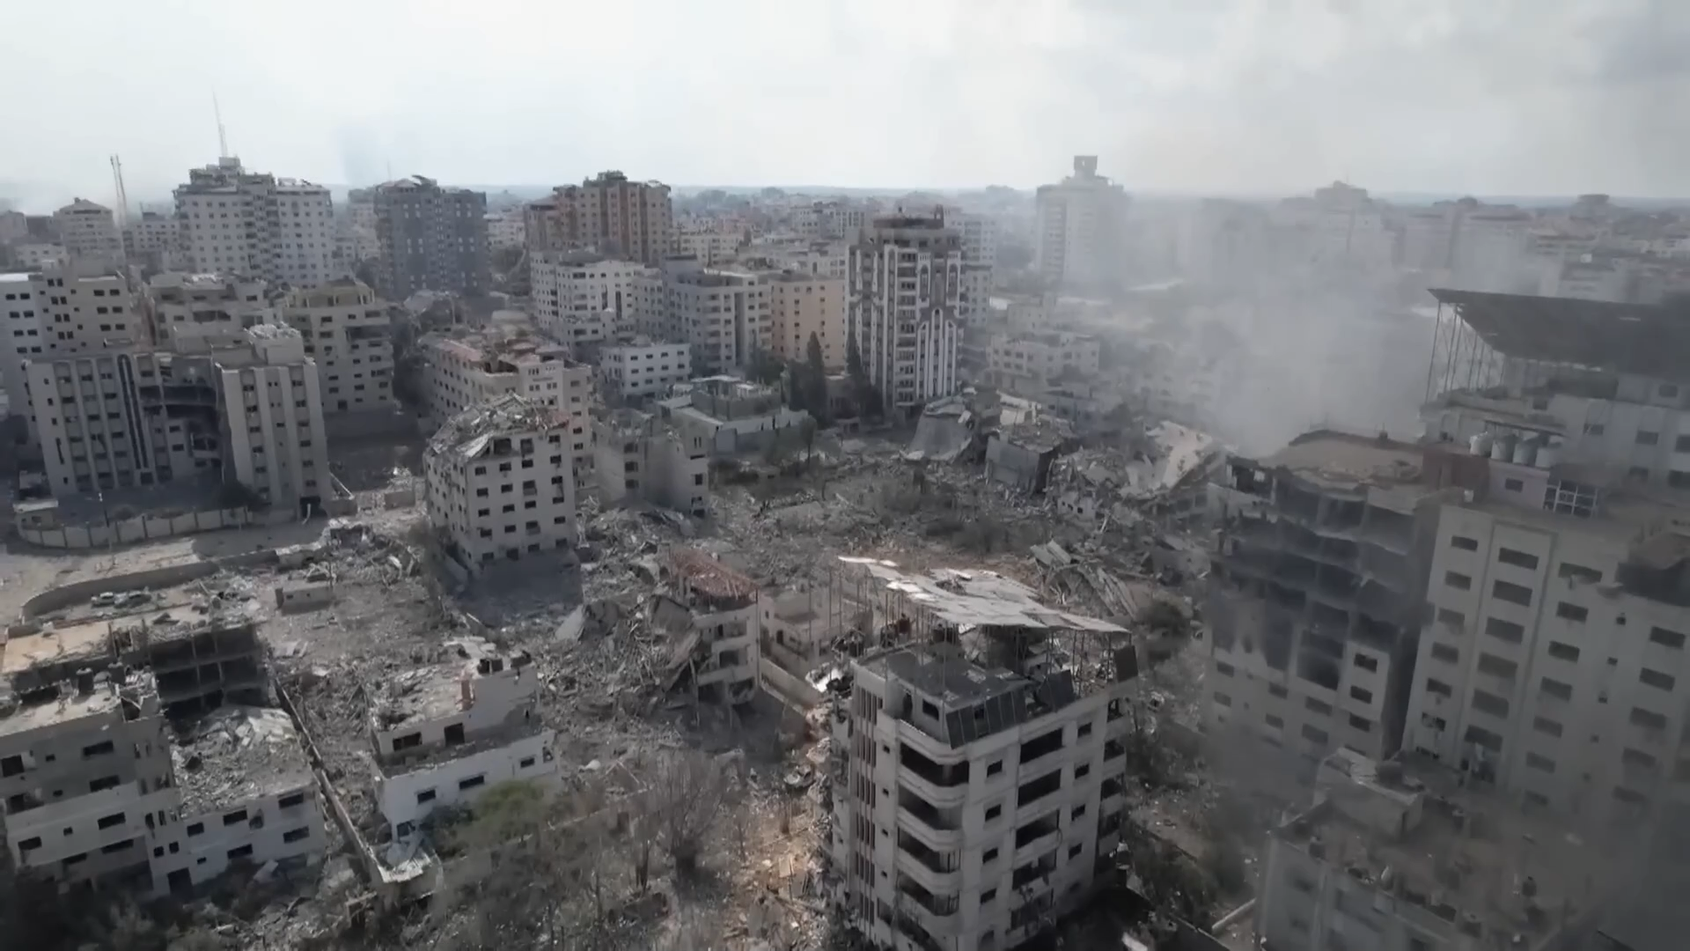
38 Million People
Affected by displacement due to war.
How do we mitigate outbreaks of infectious and genetic diseases in post-conflict areas?

Slide 3
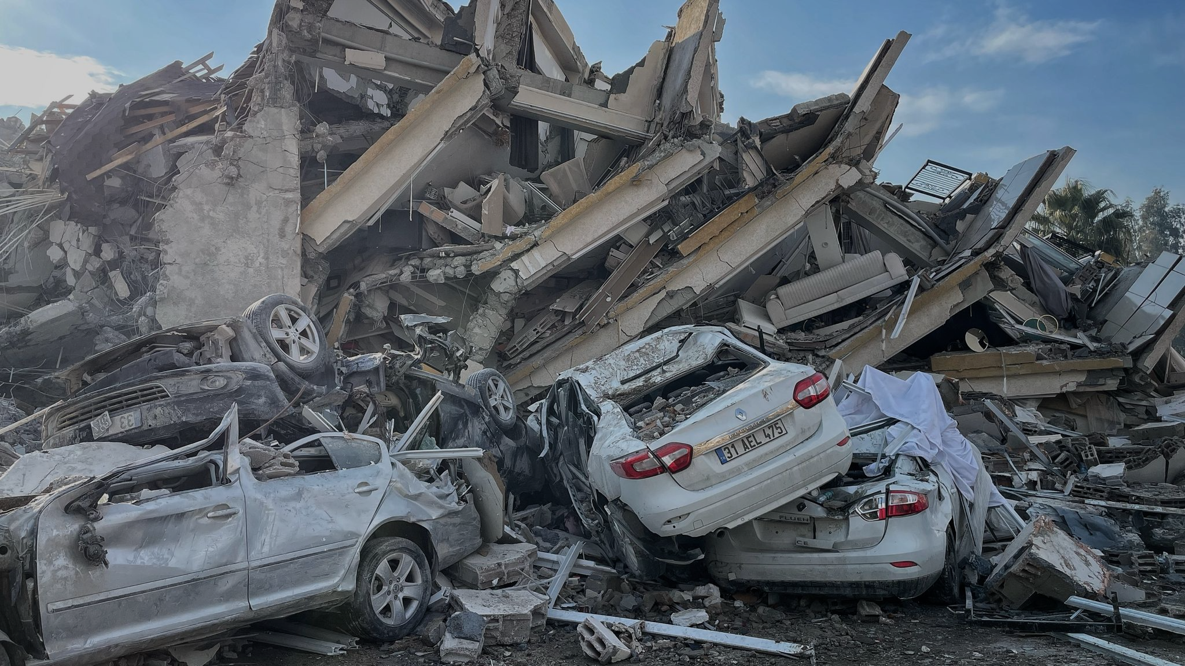
40 Million People
Affected by displacement due to natural disasters.
How do we mitigate outbreaks of infectious and genetic diseases in post-conflict areas?

Slide 4
5000%
Average increase in disease incidence rate and genetic predisposition after a catastrophe.
How do we mitigate this?

Slide 5
5000%
Average increase in disease incidence rate and genetic predisposition after a catastrophe.
How do we mitigate this?

Slide 6
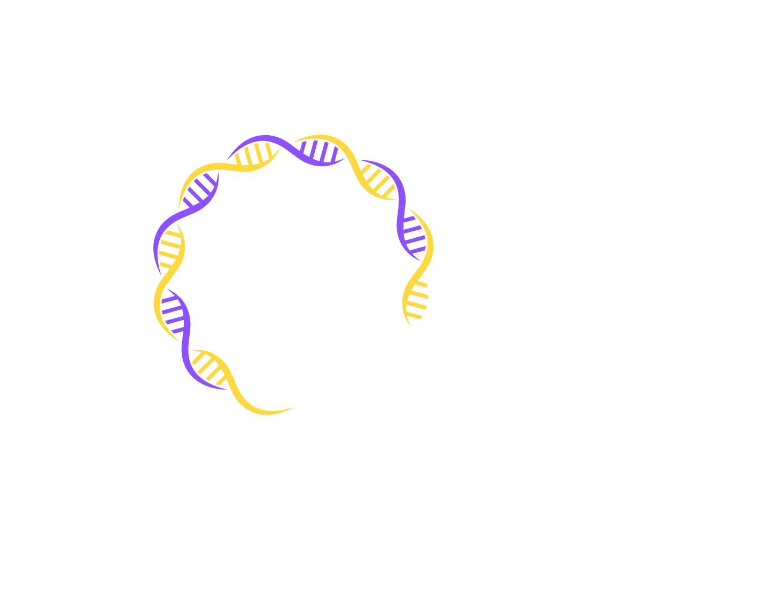


Slide 9
Rising from the ashes
AlfiniQ
الفينيق
Reviving civilizations, one genome at a time

Slide 10


Rising from the ashes
AlfiniQ
الفينيق
Reviving civilizations, one genome at a time

Slide 11
Rising from the ashes
AlfiniQ
If people know what they are genetically predisposed to after a crisis, they can detect and prevent risks in the future.
Quantum-accelerated genomic sequencing efficiently scales genomic sequencing for the millions affected by catastrophes.
الفينيق
Reviving civilizations, one genome at a time

Slide 12

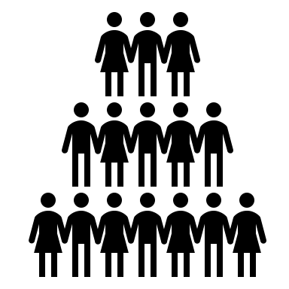




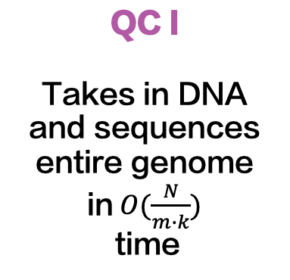
ALFINIQ PROJECT WORKFLOW
LLM + AI
Takes in crisis conditions and outputs the list of disease that are likely to outbreak
QC II
Efficiently finds genetic predisposition in a given sequence
Displacement
Chemical Weapons
Food Shortage
Poor Sanitary Conditions
Civilians
Civilians affected by crisis provide their DNA and conditions
QC I
Takes in DNA and sequences entire genome in $O(\frac{N}{m∙k})$
time
Notes:
photo3idea_studio
<a href="https://www.flaticon.com/free-icons/quantum" title="quantum icons">Quantum icons created by Wichai.wi - Flaticon</a>

Slide 13
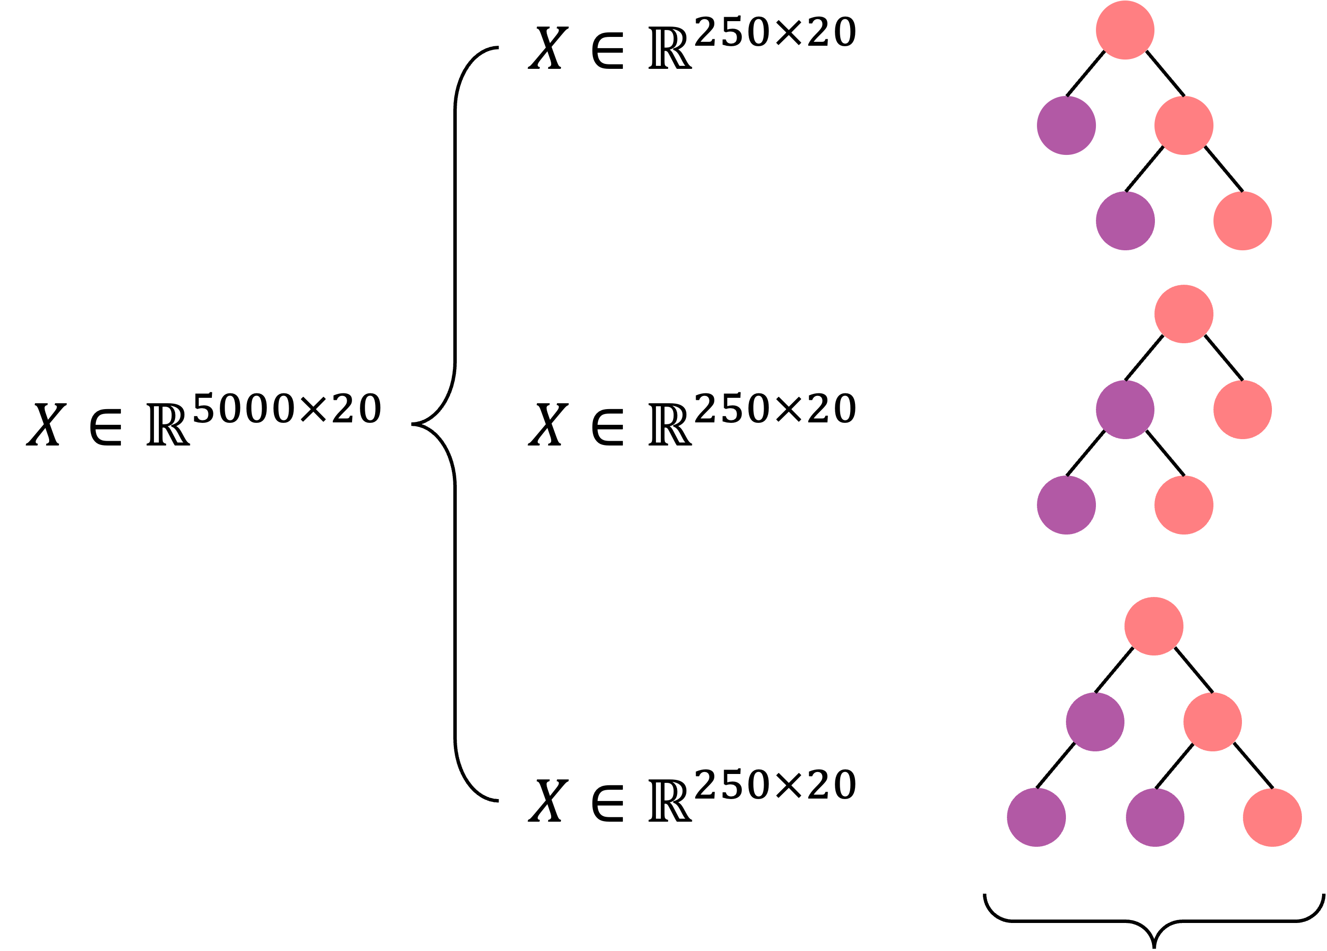
LLM + AI
Random Forest for Disease Prediction
01
02 Disease Prediction
Bootstrapping
 | Precision | Recall
Class 1 | 0.927 | 0.942
Class 2 | 0.926 | 0.955
Class 3 | 0.936 | 0.880
Class 4 | 0.889 | 0.927
Class 5 | 0.92 | 0.902
Accuracy | 0.920 | 0.901
Aggregation

Slide 14
QC I
Quantum Accelerated Genome Sequencing
Classical reference- guided DNA sequence alignment scales linearly.
Instead, encode reference + test in qubits.
Quantum algorithm provides 1/n speedup for the size of the genome.
01
02
03
Varsamis, G. D., Karafyllidis, I. G., Gilkes, K. M., Arranz, U., Martin-Cuevas, R., Calleja, G., ... & Wong, J. (2023). Quantum gate algorithm for reference-guided DNA sequence alignment. Computational Biology and Chemistry, 107, 107959.

Slide 15
QC II
Quantum Enhanced Pattern Matching
Classical pattern matching in genomics is a computationally intensive process.
Instead, utilize specialized Grover search, optimized for bioinformatics.
Quantum algorithm provides quadratic speedup for genome search.
01
02
03
Varsamis, G. D., Karafyllidis, I. G., Gilkes, K. M., Arranz, U., Martin-Cuevas, R., Calleja, G., ... & Wong, J. (2023). Quantum gate algorithm for reference-guided DNA sequence alignment. Computational Biology and Chemistry, 107, 107959.

Slide 16
Data Privacy
Switch to early PQC solutions
Companies MUST integrate Post- Quantum Cryptography (PQC).
Our solution encrypts DNA data using Lattice Based Cryptography which has yet to be broken by classical or quantum computers!
2024
2030
Switch to future PQC
2024
2030
Adapt to future PQC
2024
2030

Slide 17
Interviews with real people from war-affected areas
20 participants and relatives coming from Algeria, Iraq, Lebanon, Palestine, Bangladesh, Yemen, Bosnia
90%
are willing to do a DNA test to protect their future.

Slide 18



Project Governance
NGOs for DNA extraction and sequencing

Slide 19



Impact
Protecting futures for more than 100 million Arabs affected by catastrophe/war/genocide.
Genome analysis time reduction by 92.7%, 12 weeks to 1, scaling to all Arabs.
Revitalize and support $114B healthcare workforce after catastrophe
Greater trust in the scientific system and medicine for
2﻿00 million rural Arabs.

Slide 20
Project Timeline
1 year
Data Collection
2 years
Prototype and Data Assistance
1.5 year
Sequencing Analysis Complete
3 years
Alpha version

Slide 21
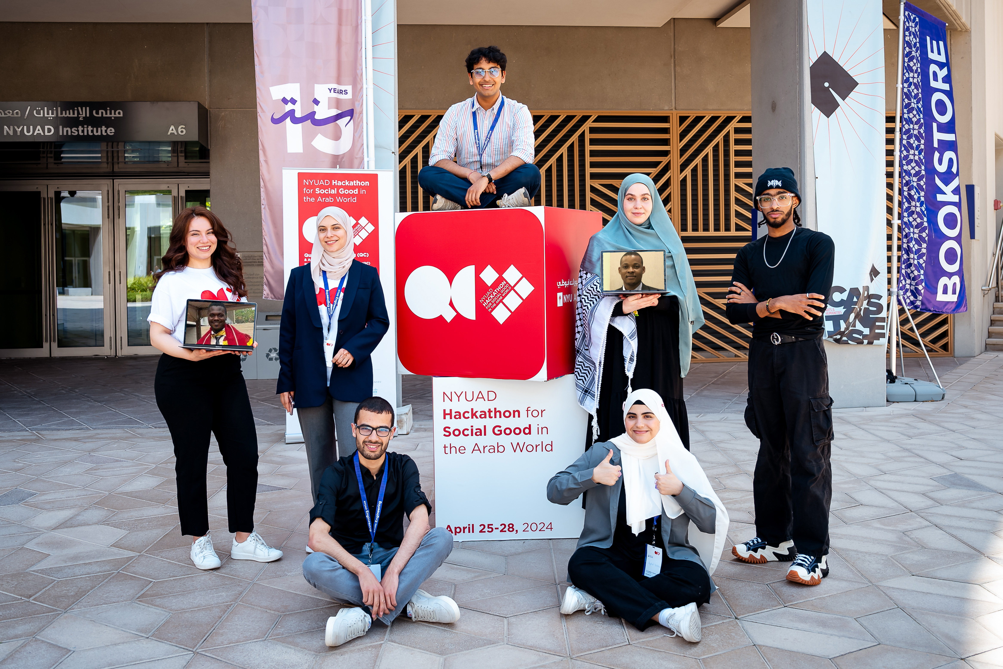
Lyna, Algeria
Pranet, USA
Ajla, Bosnia and Herzegovina
Sahar,
Tunisia
Mohamed,
Sudan
Segun,
Nigeria
Okeke,
Rwanda
Abderrahmene, Algeria
Raghad, Jordan/Palestine

Slide 22


GitHub repository:
Read our docs!

Slide 23
Funanage V. L. (2021). Impact of Genetic Testing on Human Health:: The Current Landscape and Future for Personalized Medicine. Delaware journal of public health, 7(5), 10–11. https://doi.org/10.32481/djph.2021.12.005
Varsamis, G. D., Karafyllidis, I. G., Gilkes, K. M., Arranz, U., Martin-Cuevas, R., Calleja, G., ... & Wong, J. (2023). Quantum gate algorithm for reference-guided DNA sequence alignment. Computational Biology and Chemistry, 107, 107959.
Cost of War, (2023). Winston Institute. Available at: https://watson.brown.edu/costsofwar/costs/human

